Slide 1
E-Portfolio Presentations & Victory Lap
E-Portfolio Presentations & CSE 390B Victory Lap

Slide 2
Lecture Outline
Final E-Portfolio Presentations
Presentation Instructions and Feedback
CSE 390B Reflection and Victory Lap
Metacognitive Skills
Nand2Tetris Projects

Slide 3
E-Portfolio Presentation Instructions
Please keep your presentations between 6-10 minutes
Eric will give you a reminder when you have two minutes left
During a presentation, please write down on a notecard questions, compliments, feedback, or constructive criticism for their e-portfolio or presentation
We will spend time sharing some after the presentations
After the sharing, you will hand the notecard to the presenter

Slide 4
Lecture Outline
Final E-Portfolio Presentations
Presentation Instructions and Feedback
CSE 390B Reflection and Victory Lap
Metacognitive Skills
Nand2Tetris Projects

Slide 5
Remember this?
The UW Student Experience
Math
Metacognitive
Skills
CSE
Nand2Tetris
Projects
Sociology
CSE 390B

Slide 6
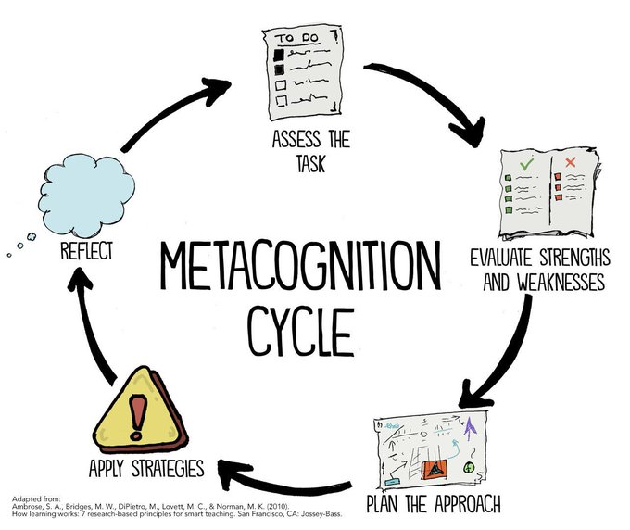
Metacognitive Skills Victory Lap!
Time Management
Note-Taking
Annotation
Exam Preparation
Test-Taking
Post-exam Reflection
Debugging
Working with Instructors & TAs
Reflection on Metacognition

Slide 7
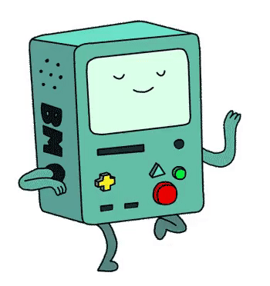
Nand2Tetris Projects
By building a computer, you’ve accomplished something that very few others have done!
Many software writers consider building the computer as Somebody Else’s Problem™
But so many technical skills and CSE courses tie into this task
And even if you only write Java for the rest of time…
Understanding the “layer below” makes you a better engineer in the “layer above”!

Slide 8
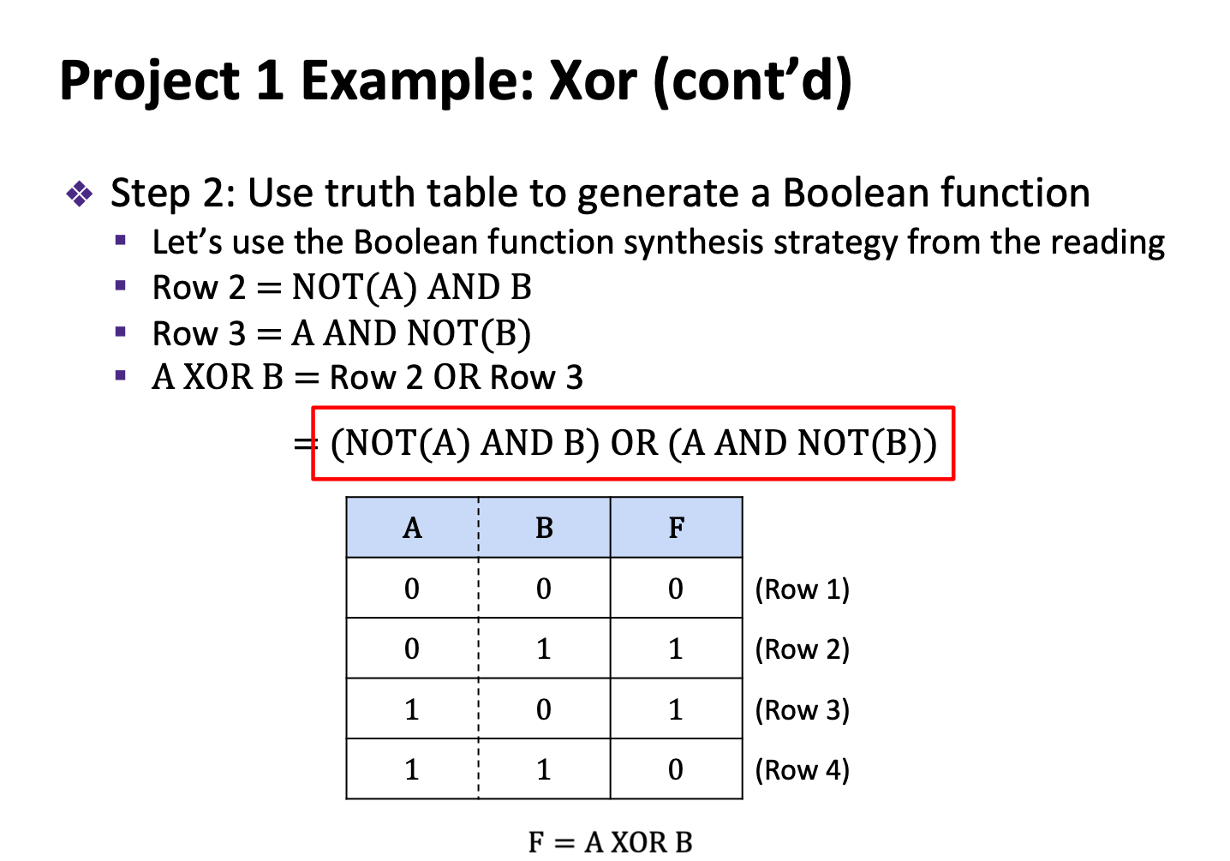
Boolean function synthesis
Practice with HDL—an unfamiliar, declarative style of programming
Project 2
Basic Logic Gates
NAND

Slide 9
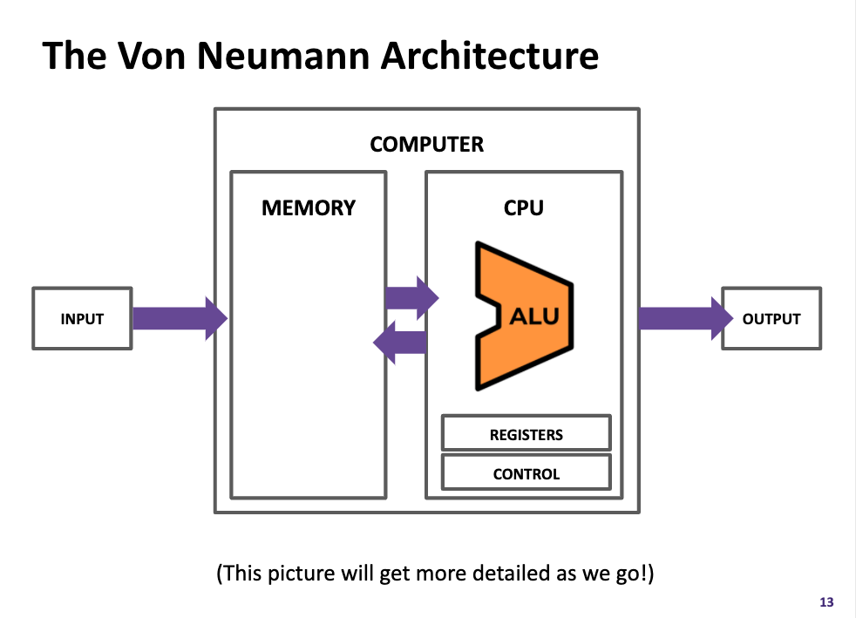
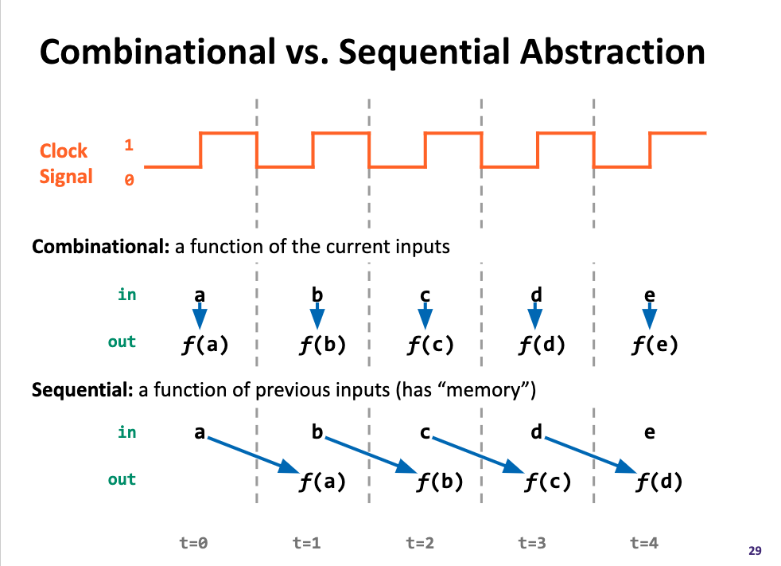
Components found in “real-world” computers: ALU, PC, Memory...
Learning a mental model for sequential logic
Project 4
Memory
Project 3
ALU
PC
Basic Logic Gates
NAND

Slide 10
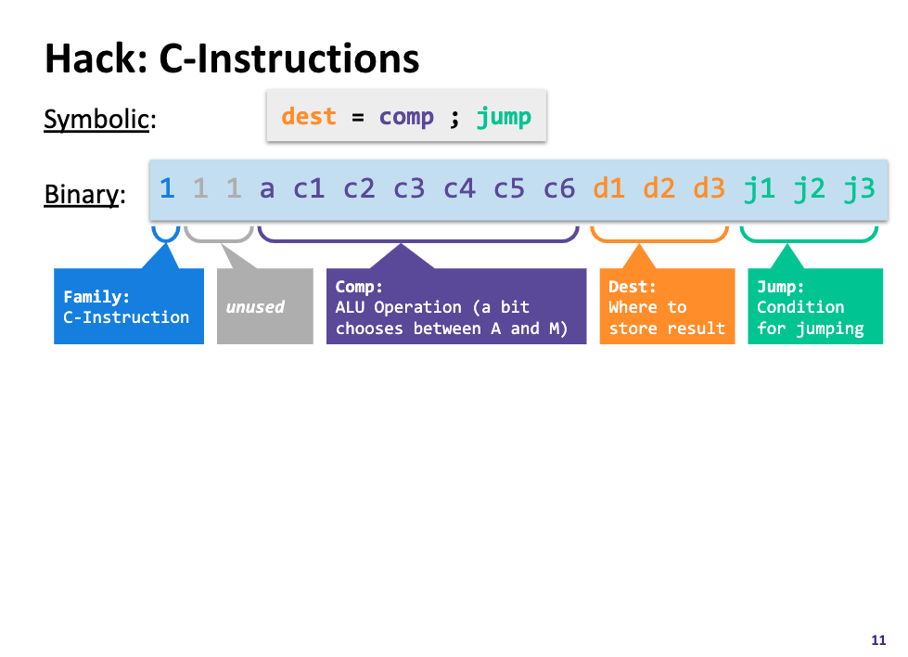
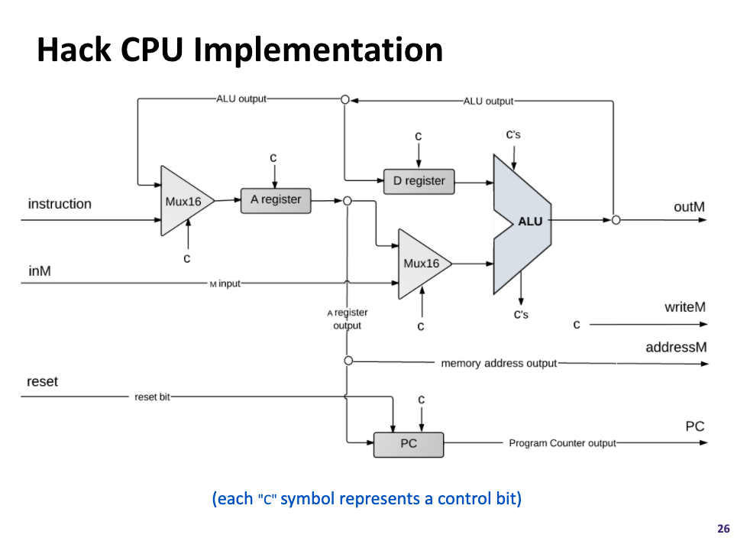
Project 5
Assembly Language
Assembler
Machine Code
Project 6
Computer
Memory
CPU
The connection between software and hardware through binary instructions
What must happen in a clock cycle to process one instruction
ALU
PC
Basic Logic Gates
NAND

Slide 11
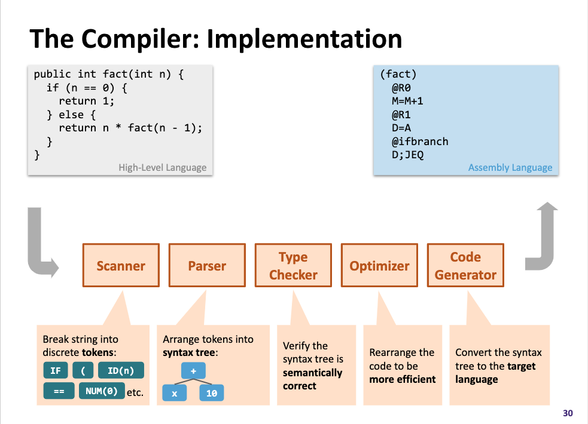
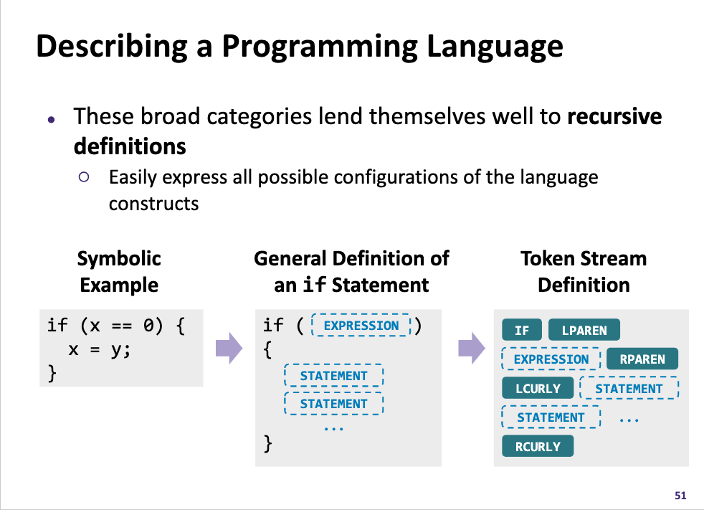
High-Level Language
Project 8
Intermediate Language(s)
Assembly Language
Operating System
Assembler
Machine Code
Computer
Memory
CPU
What happens when you click that green run button?
Programs can read in programs and then spit out equivalent programs
ALU
PC
Basic Logic Gates
NAND

Slide 12
Roadmap
SOFTWARE
HARDWARE
High-Level Language
Intermediate Language(s)
Assembly Language
Operating System
Assembler
Machine Code
Computer
Memory
CPU
ALU
PC
Basic Logic Gates
NAND

Slide 13
SOFTWARE
HARDWARE
331: Software Design 332: Data Structures 421: Algorithms
446: ML … & many more
341: Programming Languages
High-Level Language
Intermediate Language(s)
401: Compilers
333: Systems Programming
Assembly Language
Operating System
451: Operating Systems
452: Distributed Systems
461: Networks
Assembler
351: HW/SW Interface
Machine Code
Computer
Memory
CPU
469: Computer Architecture
ALU
PC
311: Foundations I
Basic Logic Gates
369: Digital Design
NAND
371: Digital Circuits

Slide 14
Takeaways: Why Build a Computer?
A significant engineering effort
You practiced so many skills and programmed with so many different languages, tools, & paradigms—and you can do it again!
We hope this was a demystifying experience
To not see CSE courses as isolated but as interconnected puzzle pieces
We hope you had fun in this learning journey!
The computing field is broad and has much for you to explore
We are hopeful you found a topic you want to pursue further, both technically and metacognitively

Slide 15
Closing Remarks
The course staff has observed your learning and we are incredibly proud of the ways you have grown
We hope you’ll continue to grow in metacognition and remember bottom-up computing as you continue in your CSE journey
This is just the beginning — there are a plethora of ways to grow from what we’ve explored in this class
Thank you all for a wonderful quarter!
Stay in touch and we hope to see you around in the future! 👋

Slide 16
Post-Final Lecture Reminders
Office hours and student-TA 1:1 meetings ended last week
Course staff open to meeting during finals week by appointment
If you have any uncompleted projects, the last day to turn them in is this Friday (3/17) at 11:59pm
Please fill out course evaluations if you haven’t already
Have a wonderful break! We hope to see you around in future quarters!

